Slide 1

Capstone Project
EDA on Airbnb Bookings Analysis by DEEPAK DOBAL

Slide 2

Objective
1.Problem statement
2.Understanding our data
3.The columns involved
4. Installing Dependencies1.
5. Exploratory Data Analysis1
6.Obtaining Critical Insights

Slide 3
What Is Airbnb?
Airbnb, as in “Air Bed and Breakfast,” is a service that lets property owners rent out their spaces to travelers looking for a place to stay. Travelers can rent a space for multiple people to share, a shared space with private rooms, or the entire property for themselves.

Slide 4
Project Summary
Since 2008, guests and hosts have used Airbnb to expand on traveling possibilities and present a more unique, personalized way of experiencing the world. Today, Airbnb became one of a kind service that is used and recognized by the whole world. Data analysis on millions of listings provided through Airbnb is a crucial factor for the company. These millions of listings generate a lot of data - data that can be analyzed and used for security, business decisions, understanding of customers' and providers' (hosts) behavior and performance on the platform, guiding marketing initiatives, implementation of innovative additional services and much more.

Slide 5

Problem statement
What can we learn about different hosts and areas?
What can we learn from predictions? (ex: locations, prices, reviews, etc)
Which hosts are the busiest and why?
Is there any noticeable difference of traffic among different areas and what could be the reason for it?

Slide 6
Understanding our data
To increase the efﬁciency of our analysis we will ﬁrst have to understand the data and also check if there are some missing values,outliers,non essential features.
This dataset has around 49,000 observations in it with 16 columns and it is a mix between categorical and numeric values.
Each observation includes information about the date,host, location type of rooms etc.
The 16 columns represent different ﬁelds. We will understand each column now.

Slide 7
The columns involved
Id- It provides a unique id to each listing in the dataset.
Name-It describes the property in a concise manner.
Host_id-It is used to ascertain the ownership of a certain individual
Host_name-It is the name of the property owner
Neighbourhood_group-It basically categorizes neighbourhood into five groups Bronx,Brooklyn,
Manhattan,Staten Islands and Queens
Neighbourhood-It designates the location of a property.
Lattitude-It Specifies the Lattitude of the property.
Longitude-It denotes the Longitude of the property.
Room_type-It classifies the type of property into Private_Room,Shared_Room and Entire_Apartment.
Price- It provides the price of each listed property.
Minimum_Nights-It gives the minimum night one needs to pay for in the property.
Number_of_reviews-It is used to ascertain the number of reviews received by a property.
Reviews_per_month-It denotes the number of reviews per month.
Calcuated_host_listings_count-It corresponds to the number of properties hosted by the unique host_id
Availability_365-The number of days the property is available in a year.

Slide 8


Initial preparation
In this section I’ve loaded in the dependencies, like pandas, numpy,matplotlib,seaborn library.
The next step was to mount the drive where the data was stored.
After mounting the drive I used the pandas.read_csv() function to read the data given to us in csv format.

Slide 9
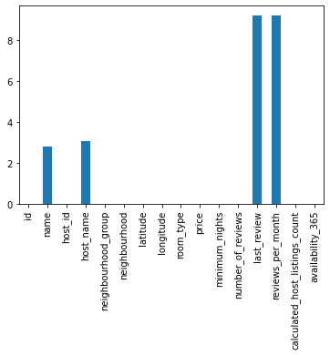
Clean up
Handling Null values: In this project the first step in Data cleaning is Handling the null values. Null values can affect the accuracy and quality of our ML models, therefore it is a good practice to handle null values.
1)Columns like name,host_name,last_review,reviews_per_month have missing values. name and host_name column is not important as it does not convey any meaningful data. So those columns can be dropped.
2)last_review and reviews_per_month have the same number of NaN values which means certain properties were not rated at all hence last_review has no date and reviews_per_month has no data so we can impute it with 0.

Slide 10
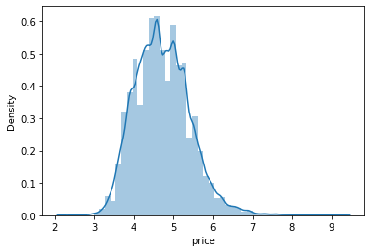
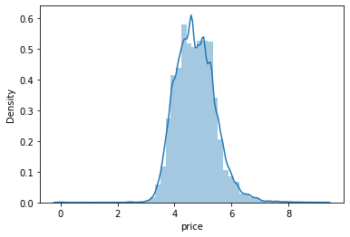
Clean up
Handling duplicate values: Duplicate values can have adverse effects on our ML models, therefore we have to try and remove it. Luckily we don’t have any duplicate values either so we can move on to the next step in data cleaning.
Data Wrangling
Imputing all price that were 0 to 50% of the values i.e 106
Changing values of 'minimum_nights' to 365 which are greater than 365
When price was 0
When price 0 replaced by 106

Slide 11
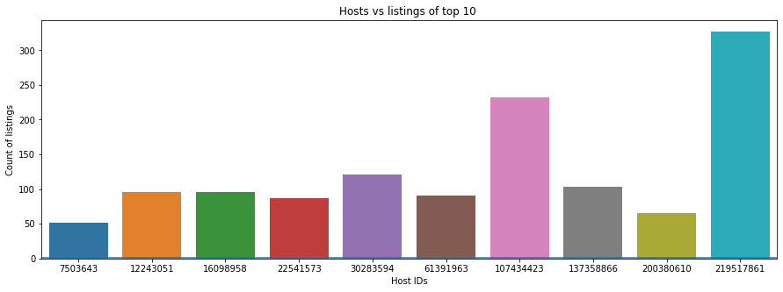
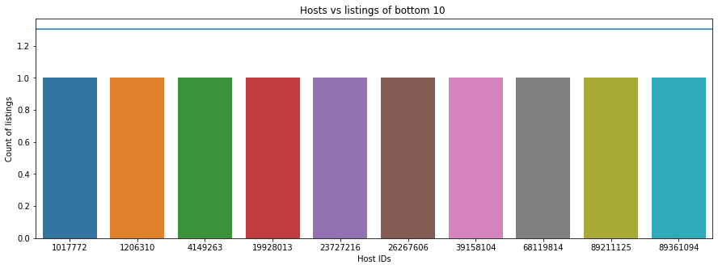
Exploratory Data Analysis :Data Vizualization, Storytelling & Experimenting with charts
some of the host are having lots of the booking then other so AirBnb must look why the customers are using their services frequently ,and from their implementation or customer services .
moreover the bottom hosts are getting only 1 booking they are not doing so well

Slide 12
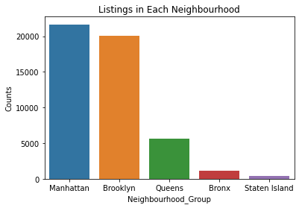
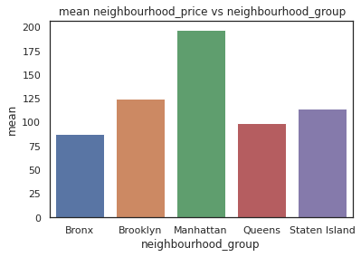
Exploratory Data Analysis
Manhatten is most popular neighborhood while staten island is least
Well this insight tells that airbnb is doing well in a particular area and not well in other area
Manhattan is the most expensive neighbourhood_group followed by Brooklyn Staten Island Queens and Bronx
people are willing to pay more in manhatten dispite being the most expensive one

Slide 13
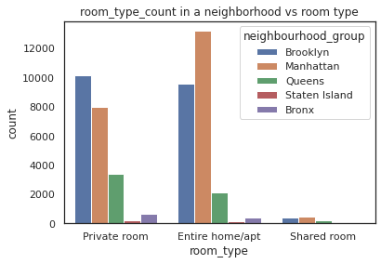
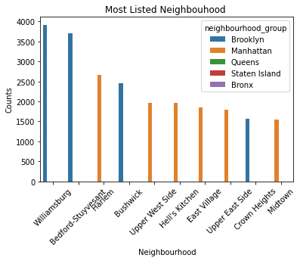
Exploratory Data Analysis
1)Most Listings offer Entire home followed by Private Room and Shared Room
2)Brooklyn offers nearly the same number of private rooms and entire home whereas Manhattan offers highest number of entire homes followed byprivate rooms.
3)Listing of shared room is very little and staten islands and bronx offer very few shared rooms
It is evident from the plot that Williamsburg,Bedford-Stuyvesant and Harlem
are the most listed neighbourhood.
Brooklyn and Manhattan has the majority share of listings in neighbourhood_group

Slide 14
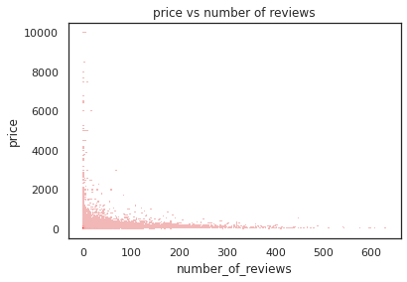
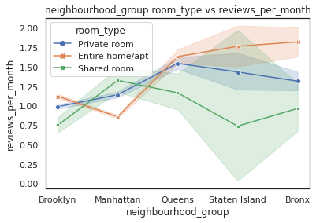
Exploratory Data Analysis
Price and Number of reviews have points very
far which do not render a proper picture, however as price increases no of listing decreases and vice versa so that might be the reason why low price rooms has more reviews
Brooklyn and Manhattan stands pretty fall in terms of review rate per month. Also, we can notice a negative relation between price & no. of reviews. Where, costlier properties has significantly less no of reviews, but cheaper properties have large number of reviews. Usually, cheaper rooms has more number of guest visits than costlier one, we know no of reviews is directly proportional to no of guests.

Slide 15
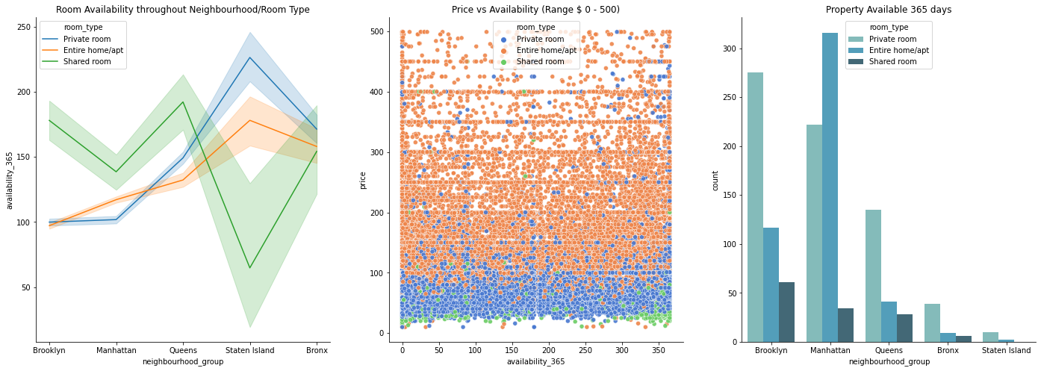
Exploratory Data Analysis
From the above graphs, Staten Island has most busiest Shared Room as well as Most available Private Room. Brroklyn and Manhattan has quite similar availabilities. On the other hand, from Price vs Availability graph, we can notice almost uniform distribution i.e. A particular room type of a particular price range can be available throughout year. \ Also there are 1295 total properties that are available 365 days a year. Manhattan tops this list with 572 properties while Brooklyn stands at second with 453 properties available.

Slide 16
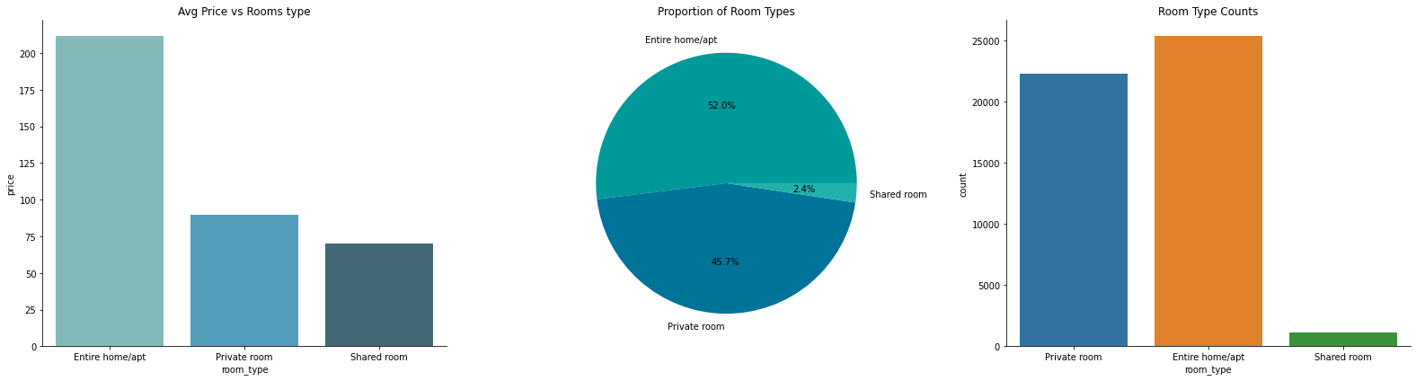
Exploratory Data Analysis
Entire home/apt has more than 50% proportion in new york city and it too has highest avg price also. Shared room are the cheapest, but only has 2.4% proportion. No wonder New York life is of high standard.

Slide 17
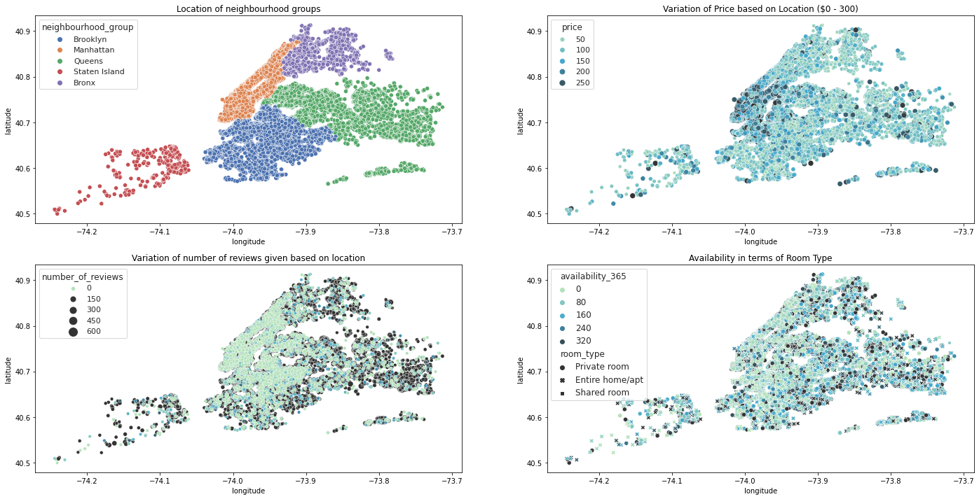
Exploratory Data Analysis
1-In the first plot we can check the neighbourhood location of New York city where our dataset currently belongs to.
2-In the second plot, we have considered only listing with a price range max to usd 300, as our 75th percentile data lies in range of usd 175. We can check how variation in prices distributed throughout the city location. The south of Manhattan and north of Brooklyn belongs to the expensive areas of New York. (Source timeout.com).
3-In the third plot, we can follow a trend in rise of the review count throughout the outskirts of city.
4-In the last plot, we've tried to visualize the availability in terms of room type. Though availability based on room type is spreaded well, still we can follow a pattern where the heart of new york stays the busiest or booked for most of the time.

Slide 18
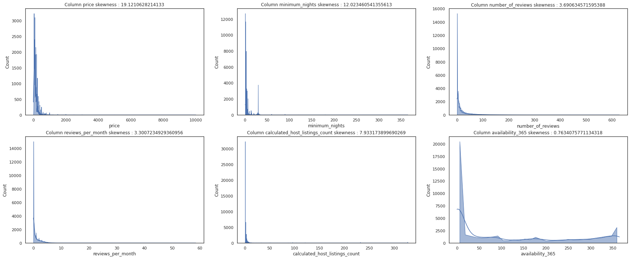
Exploratory Data Analysis
From the distribution of filtered numerical data columns, it can be concluded that all these has a positive skewed distribution including price. However, availability distributed uniformly throughout days of a year, so it means we have all sort of listing available uniformly throughout the year.

Slide 19
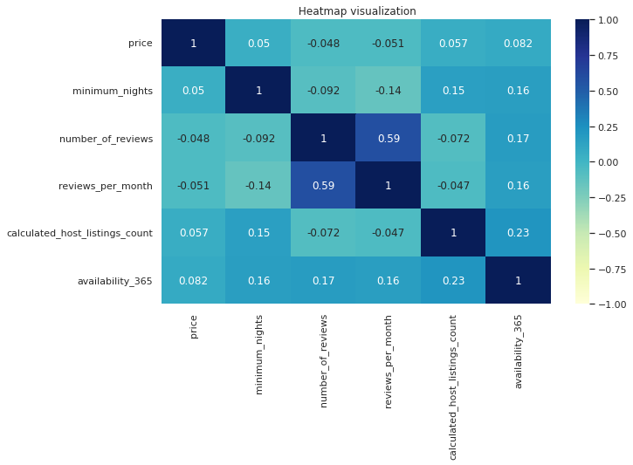
Exploratory Data Analysis
from the heat map of all the taken features we can view that features don't show a good co-relation with each other so its fine to go with same set of feature for model building

Slide 20
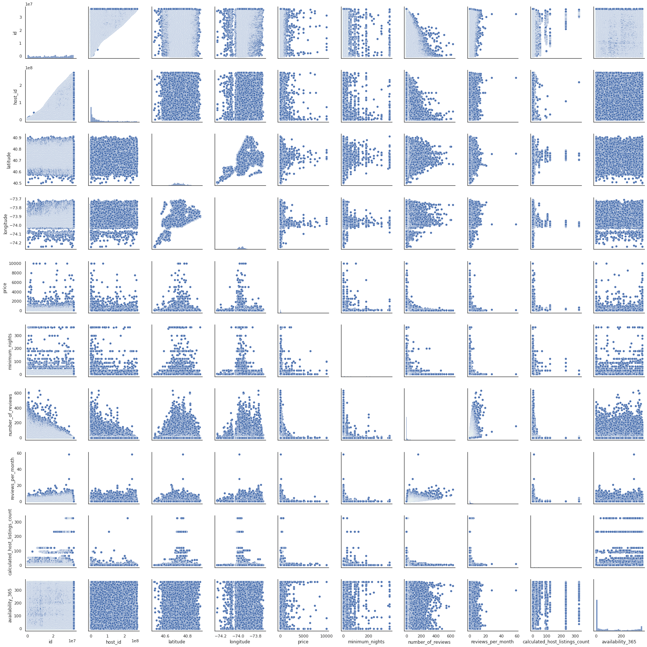
Exploratory Data Analysis
A pairs plot allows us to see both distribution of single variables and relationships between two variables .
Pair plots are a great method to identify trends for follow-up analysis and, fortunately, are easily implemented in Python.
Pair plot is used to understand the best set of features to explain a relationship between two variables or to form the most separated clusters.

Slide 21
Conclusions
So, this AirBNB dataset is a rich in data but not on features. From the entire above analysis we can conclude that.
1-Most visitors don't prefer shared rooms, they tend to visit private room or entire home.
2-Manhattan and Brooklyn are the two distinguished, expensive & posh areas of NY.
3-Though location of property has high relation on deciding its price, but a property in popular location doesn't it will stay occupied in most of the time.
4-Performing a regression on this dataset may result in high error rate, as the features given in this dataset, are of very poor quality in deciding the property valuation. We can see this by looking at correlation heatmap. We would need more features like bedrooms, bathroom, property age (guessed it'd be a very important one), tax_rate applicable on land, room extra amenities, distance to nearest hospital, stores or schools. These features might have a high relation with price.
Notes:
host_id reveals that some host have a huge number of property ownership above 300.
2. The Majority of the listings are located in Manhattan and Brooklyn whereas Bronx and Staten Island have a miniscule share.
3. Manhattan is the most expensive neighbourhood_group followed by Brooklyn Staten Island Queens and Bronx.
4. Most Listings offer Entire home followed by Private Room and Shared Room
5. Brooklyn offers nearly the same number of private rooms and entire home whereas Manhattan offers highest number of entire homes followed by private rooms.

Slide 22
Conclusions
5-We could use a time series analysis to make prediction of occupancy rate at particular time of a month, or particular time of a season.
6-It'd be a better if we had avg guest ratings of a property, that would be beneficial in understanding the property more and could also be a factor in deciding price (a low rated property tends to lower their price)

Slide 23
THANK YOU

